Slide 1
Embedded Systems Project

Slide 2
SMART DEVICE TO SHARE LIVE LOCATION IN EMERGENCIES
Jnaneswar Singaraju – Geo-location App
Krishna Kanth Srivatsava – Bluetooth Integration App
Shanmukha Sriram Ravinutala – Arduino Software Code
Charan Kaushal Sanasi - Hardware

Slide 3
Contents
Functional Block Diagram
01
Progress until Mid Evaluation
02
Progress after Mid Evaluation
03
Screenshots and Hardware pictures
04
Screenshots and Hardware pictures
05
Expected Final Results
06
Final Results
07

Slide 4
Functional Block Diagram
NODEMCU
Thingspeak Cloud
INTERNET
Phone GPS
Phone Bluetooth
MOBILE APP
Smart Button

Slide 5
Progress until Mid Evaluation
A geo-location app which sends the co-ordinates of the person who presses the button and navigation between the contacted person and the one who pressed the button.
Assembling of the hardware components.
A Bluetooth app (a basic app) which ensures that a connection is formed between the device with Bluetooth and the app.
Arduino code ensuring a connection with Bluetooth module and the app.

Slide 6
Progress after Mid Evaluation
Creating a Realtime Firebase Database that is connected with the geo-location app by updating the live current location in the database constantly.
A completely functioning Arduino Bluetooth app which when connected to Bluetooth module redirects to the geo-location app without any click (automation).
Modifying push button to wireless button using YK04 Transmitter and also NODEMCU code to upload location coordinates to thingspeak cloud
Complete Hardware integration, thingspeak code as well as debugging the errors during the trials.

Slide 7
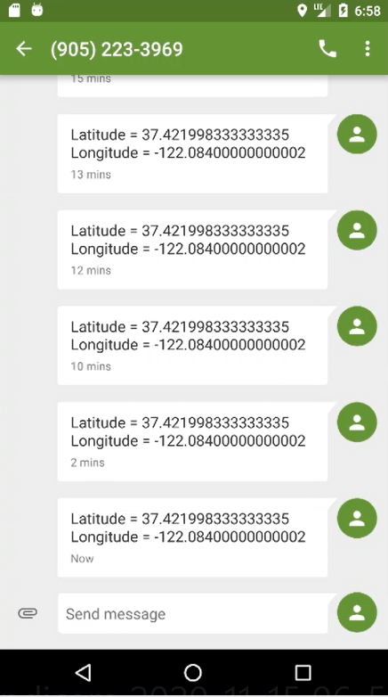
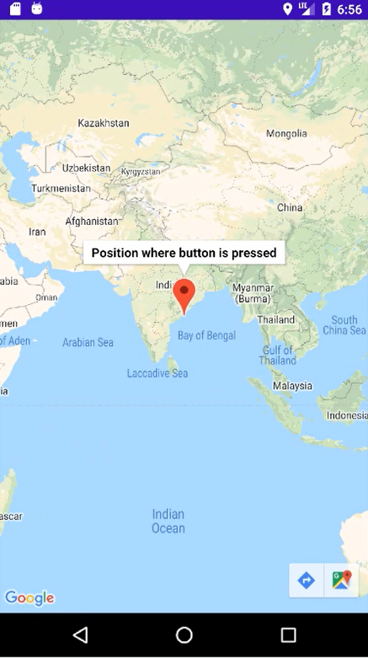
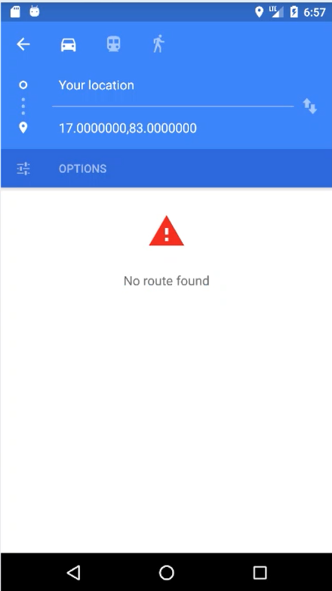
Pictures and Screenshots
Before Mid Evaluation

Slide 8
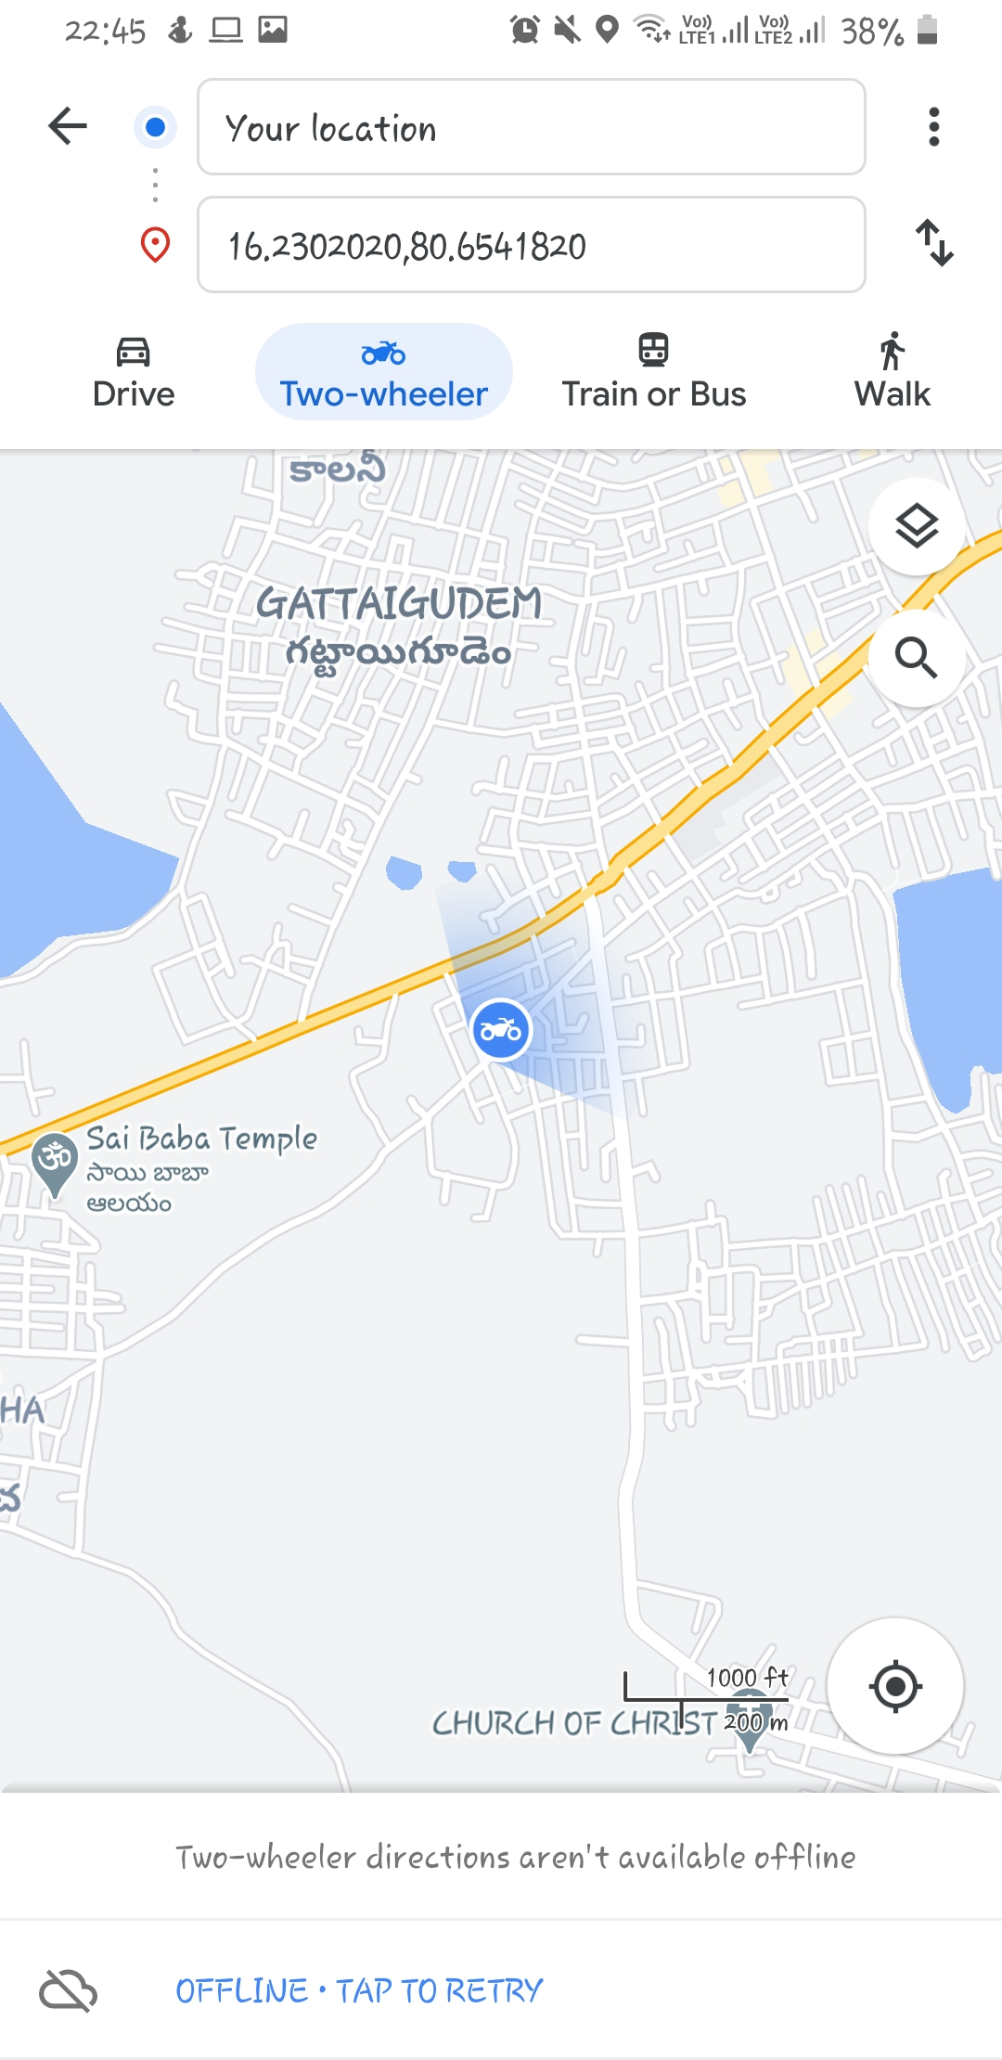
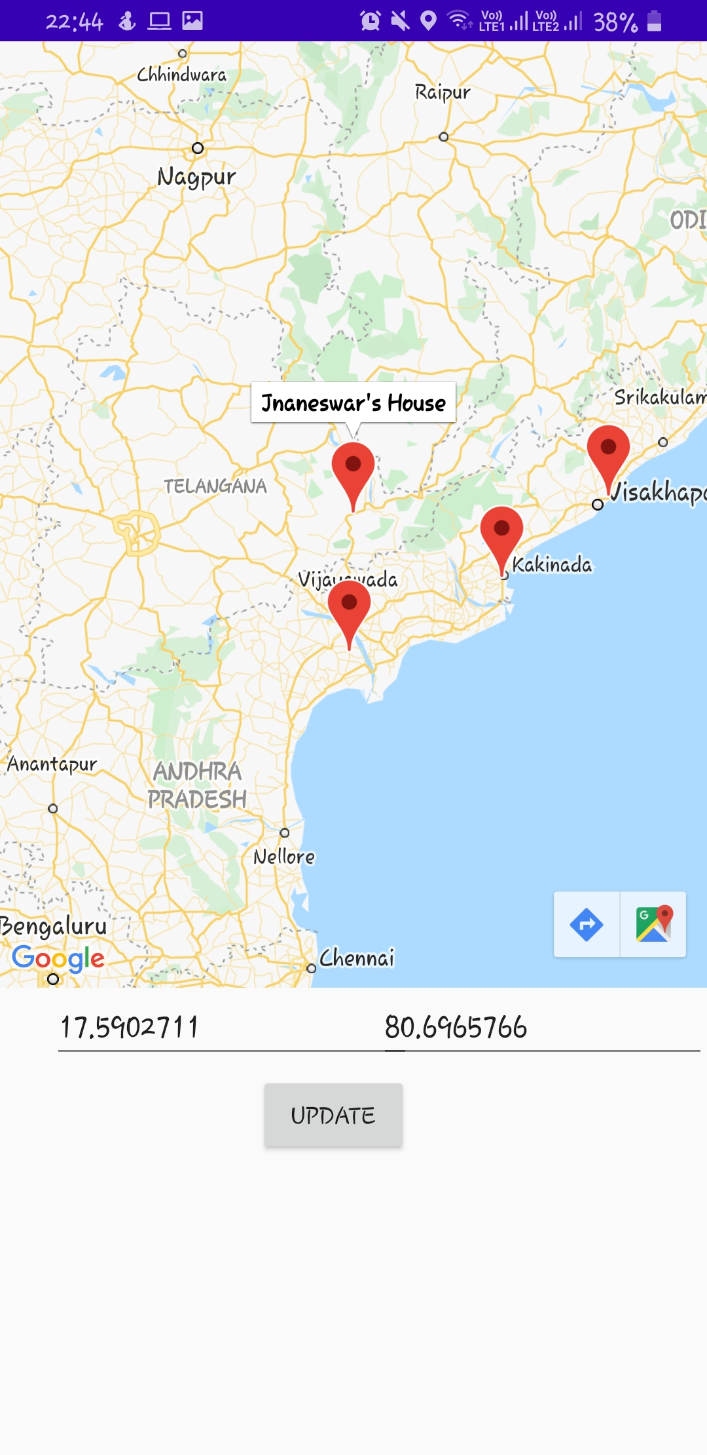
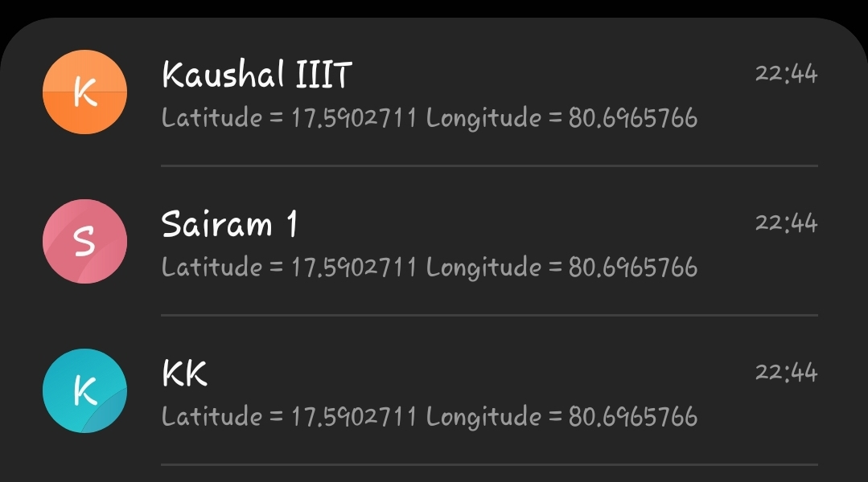
Pictures and Screenshots
After Mid Evaluation

Slide 9
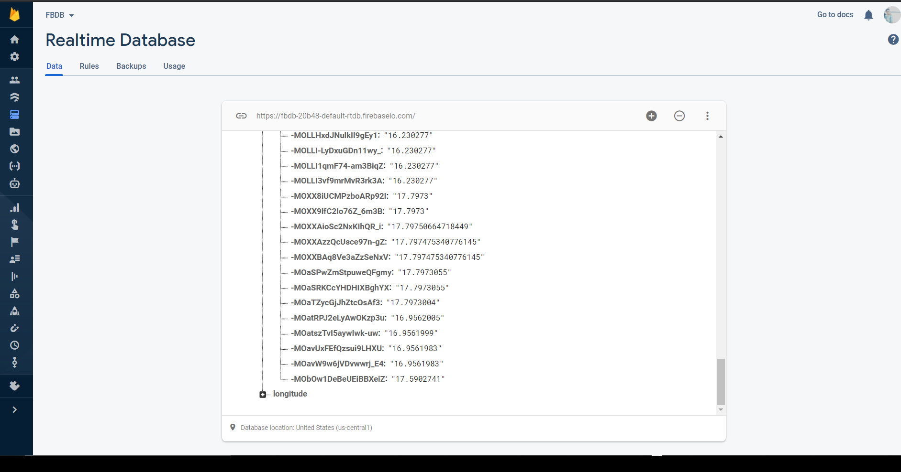
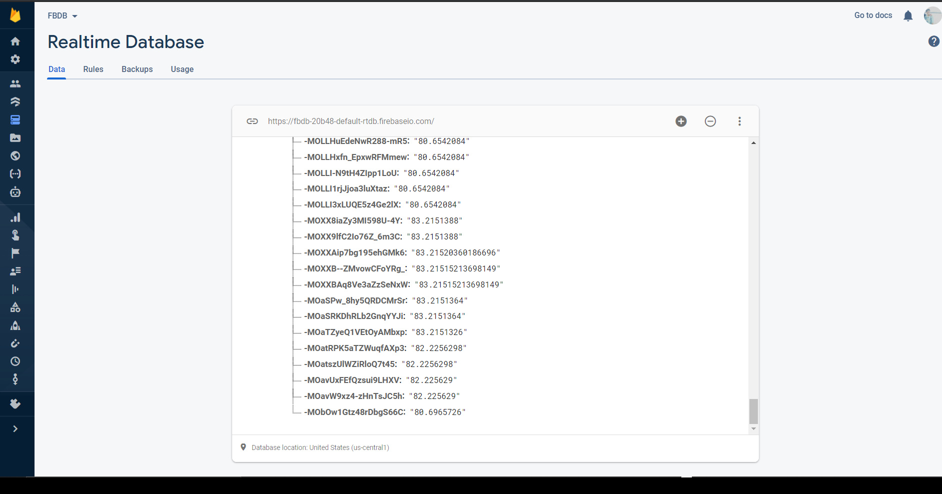
Pictures and Screenshots
After Mid Evaluation

Slide 10
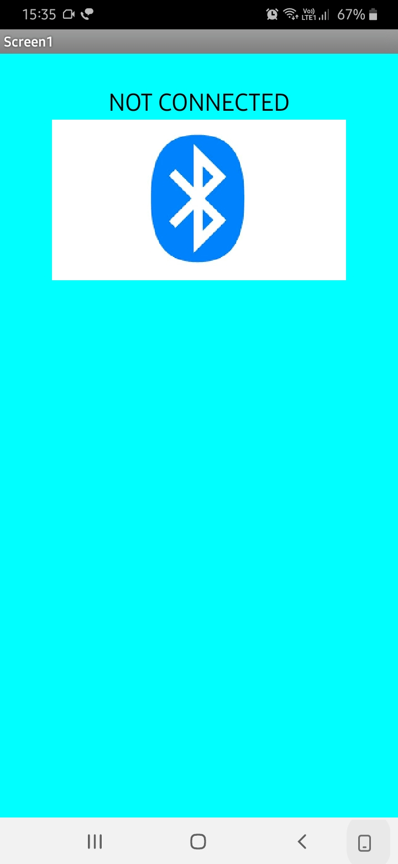
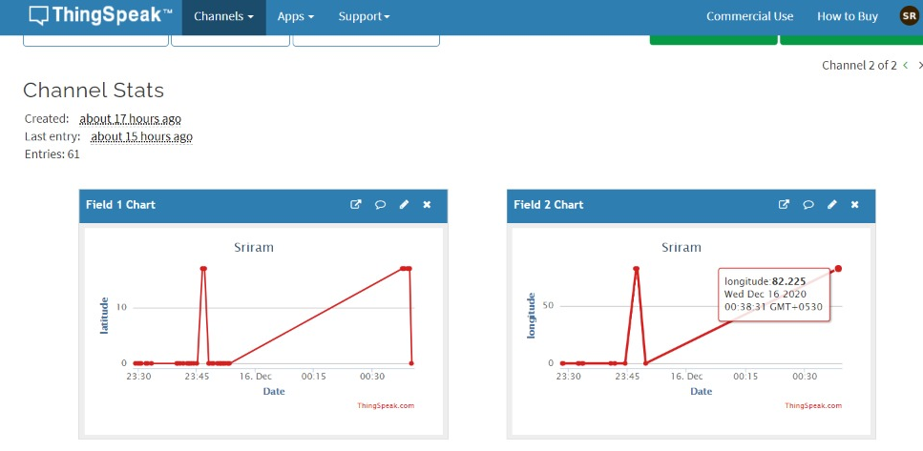
Pictures and Screenshots
After Mid Evaluation

Slide 11
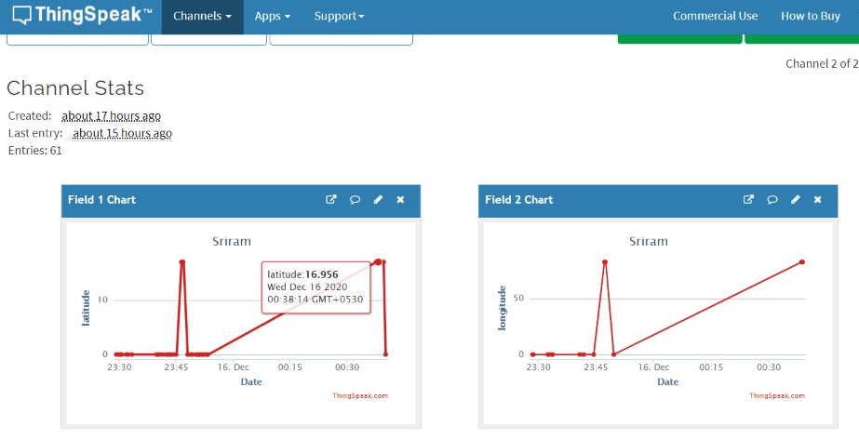
Pictures and Screenshots
After Mid Evaluation

Slide 12
Expected Final Results
A person has a safe button which when pressed performs an action between Bluetooth module and app.
The app sends the live location co-ordinates of the person to other contacts that are specified by the person.
The contacted person should be able to navigate with the help of the co-ordinates sent to him.
All of this should be done in apps.

Slide 13
Exact Final Results
A wireless button is pressed which is connected to Bluetooth module and when it’s pressed Bluetooth module and Bluetooth Arduino app that’s developed are connected.
The Bluetooth app when connected automatically redirects to another app “Map” which sends the coordinates as message to specified contacts, navigates to the other person’s location, updates the live location coordinates to a Realtime Database.
NODEMCU code to upload the location coordinates to thingspeak cloud where others can view current location.

Slide 14
THANK YOU

